Slide 1
earth moving relative to aether

Slide 2



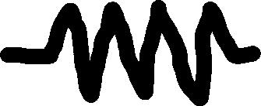

Inertial Frame
(Constant Velocity)
Non-Inertial Frame
(Accelerating)

Slide 3







$$z$$
$$z′$$
$$v$$
$$y$$
$$y′$$
$$x$$
$$x′$$

Slide 4
Aether flowing relative to earth
Earth moving relative to aether

Slide 5
Aether flowing relative to earth
Earth moving relative to aether

Slide 8


Slide 10
<S>
<S’>
D
u
L
D
W
W

Slide 12


<S>
<S’>
u
$$L_{2}$$
$$L_{1}$$

Slide 13


<S>
<S’>
$$L_{2}$$
$$L_{1}$$
u

Slide 14
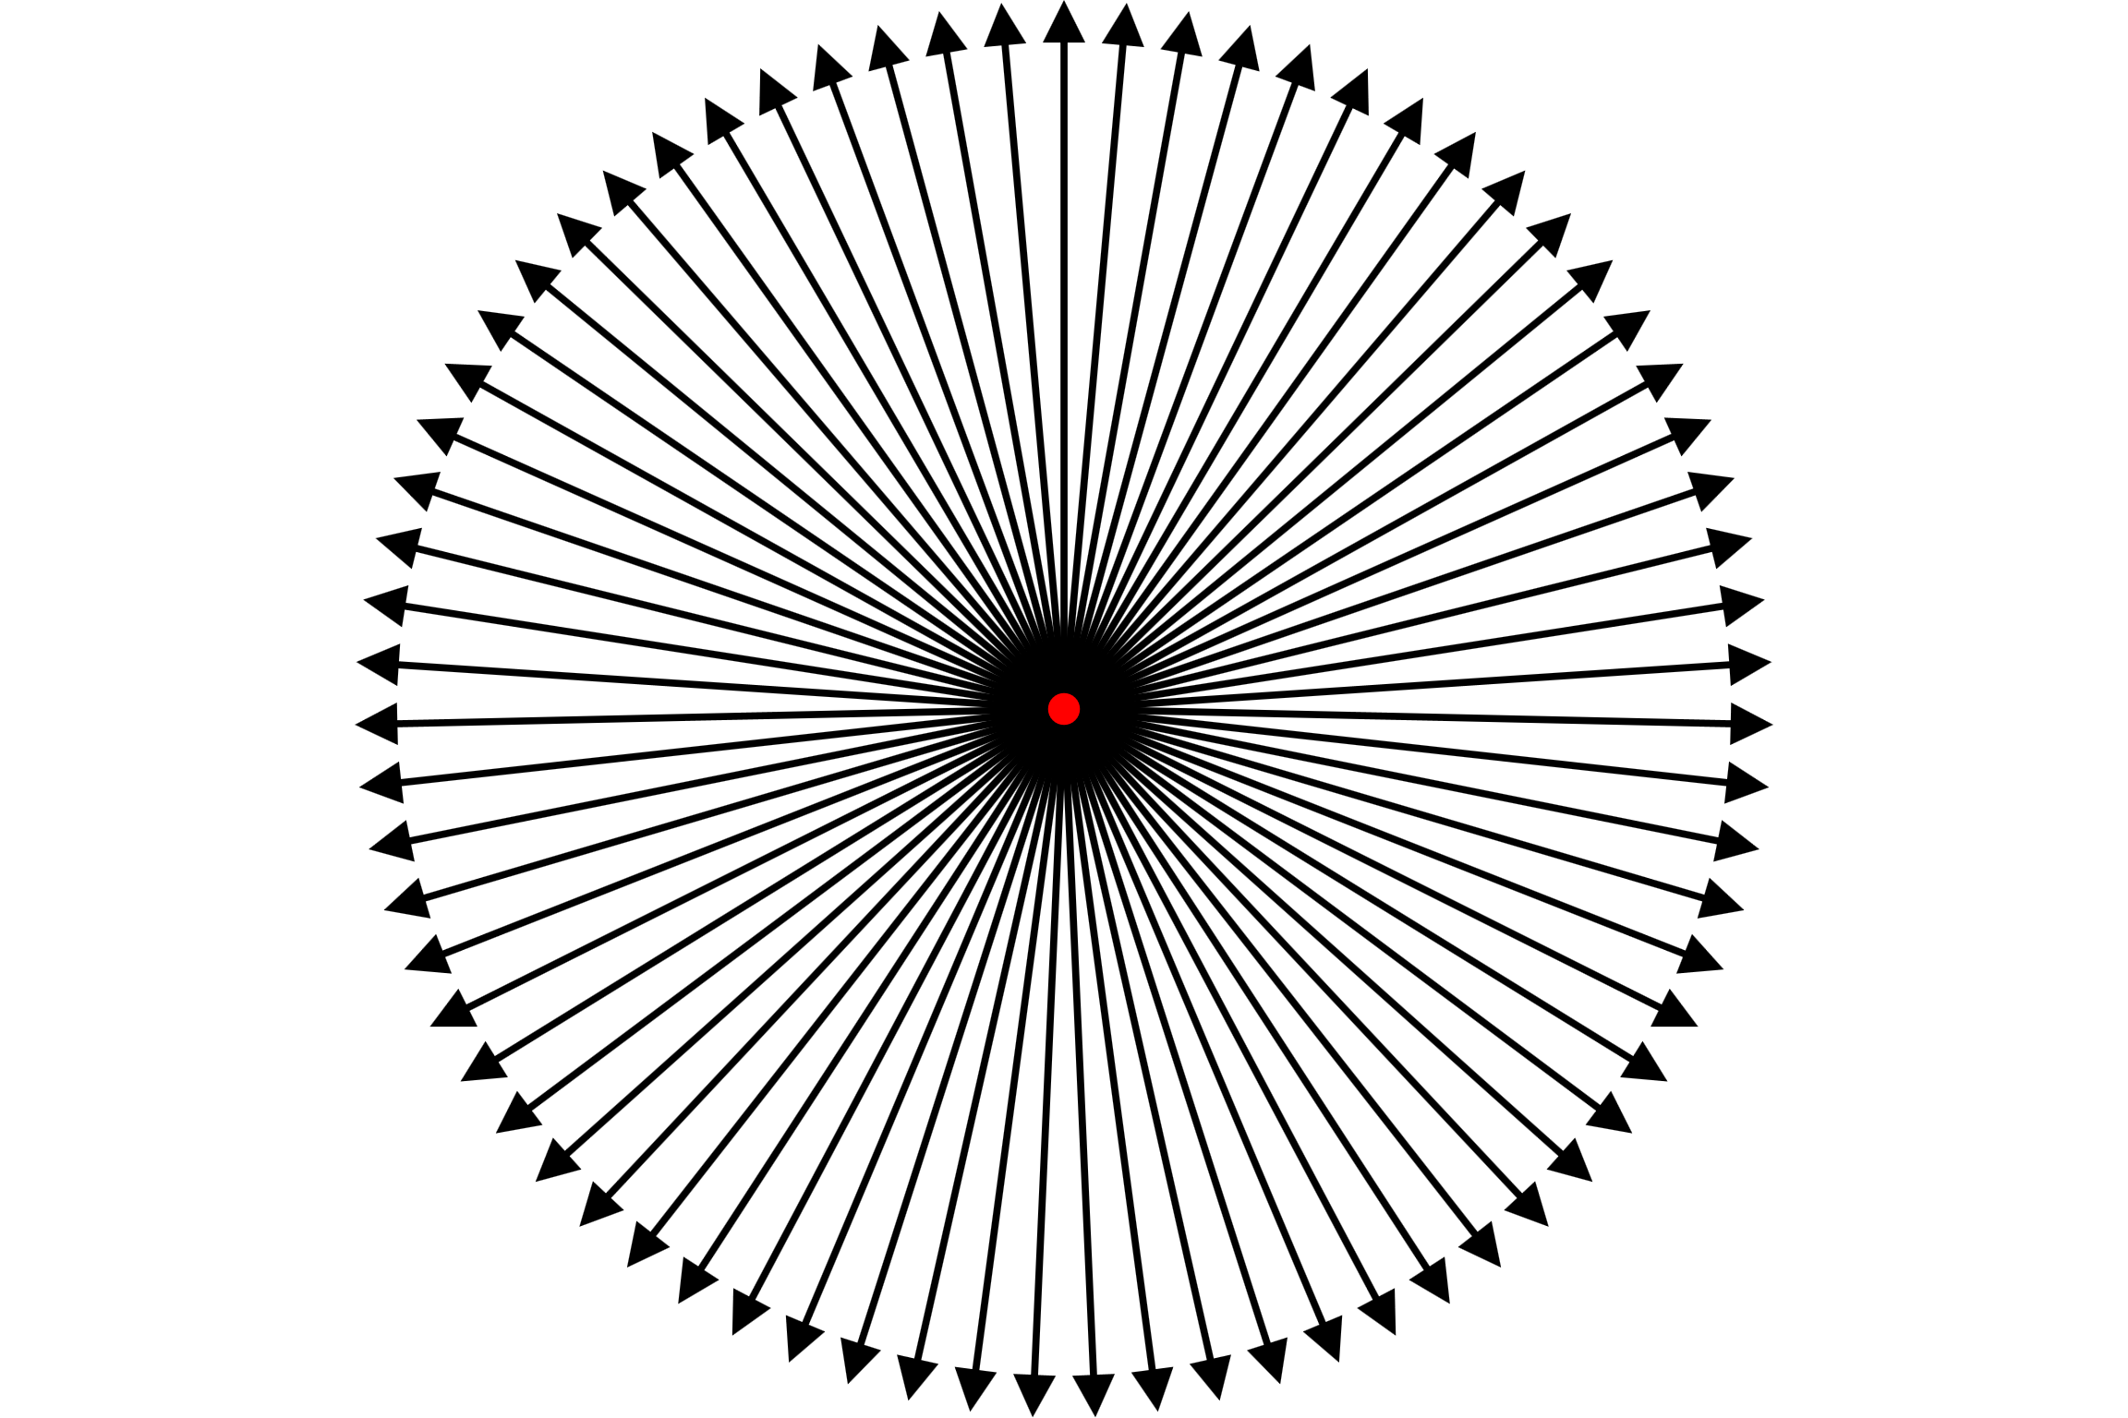
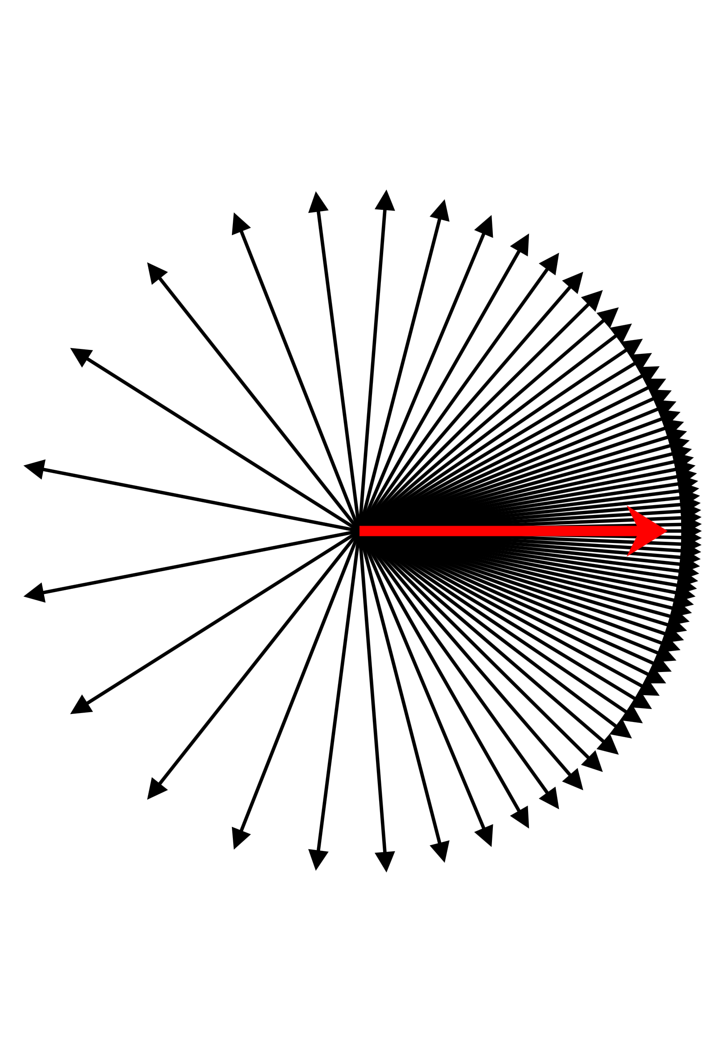

Slide 15
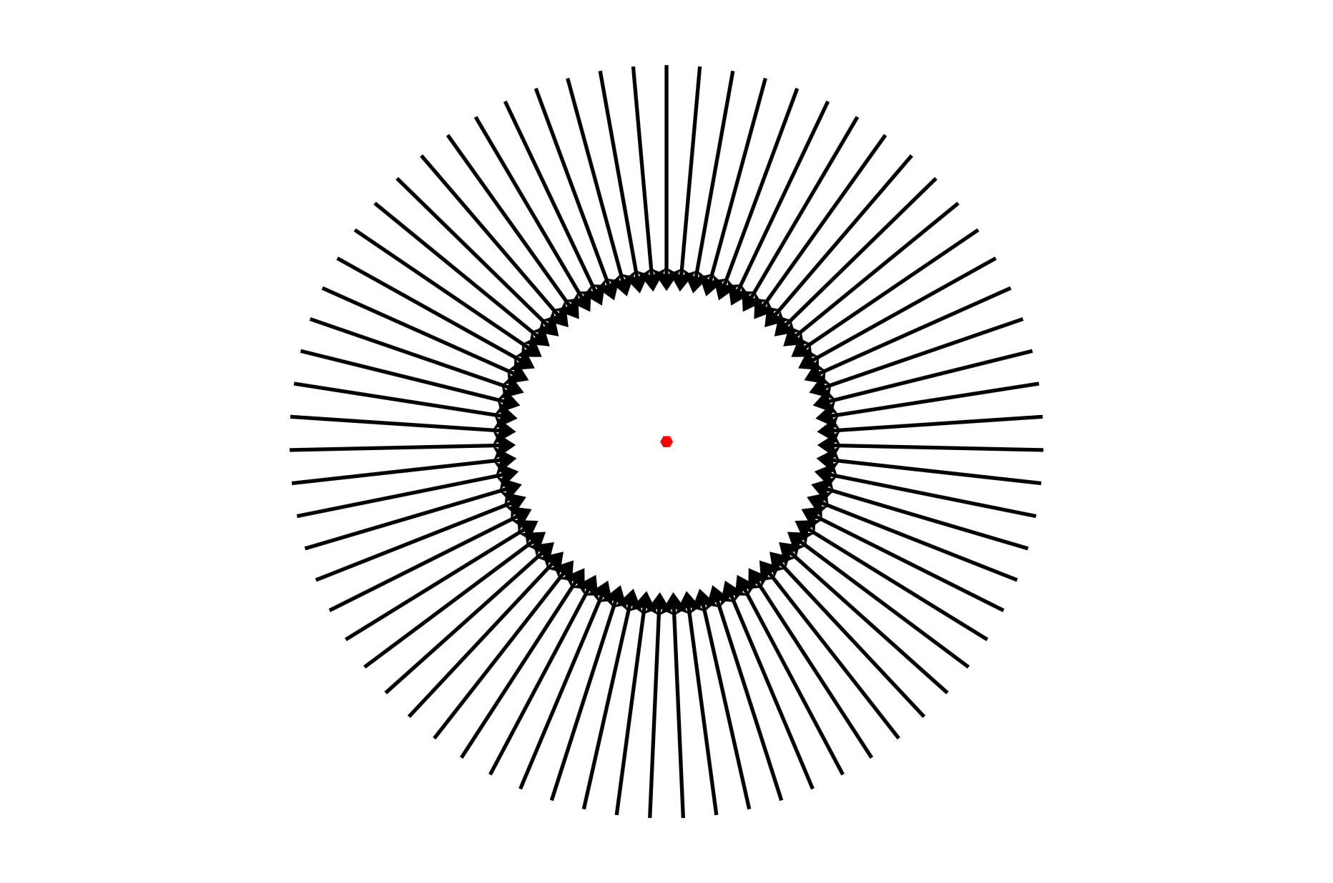
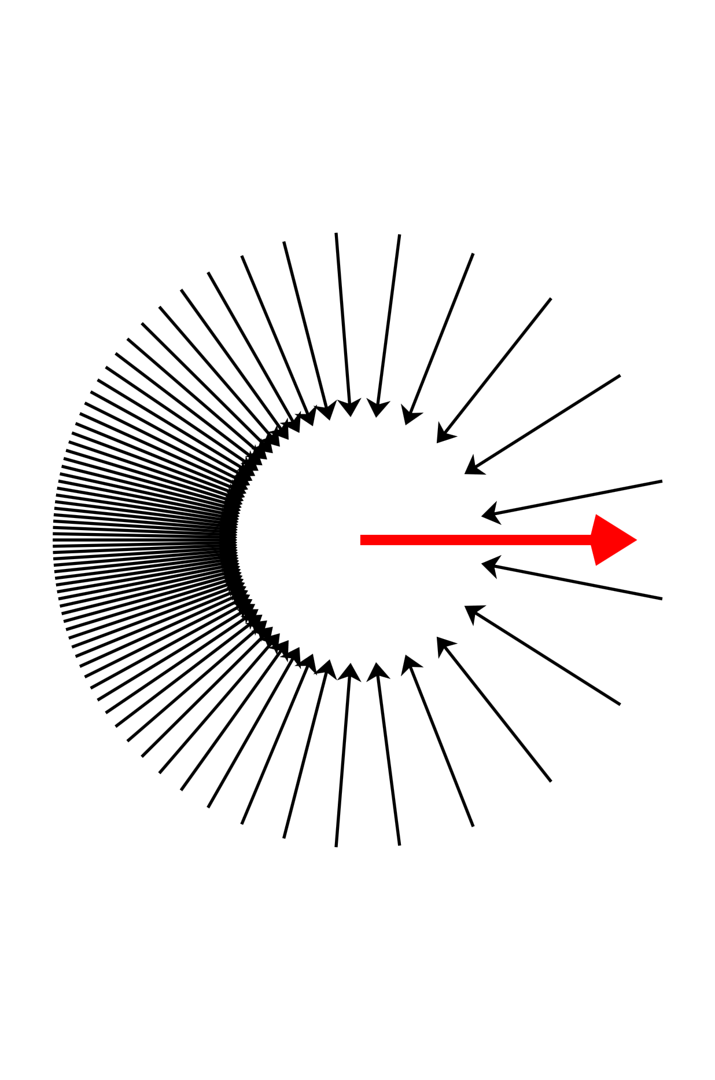

Slide 20
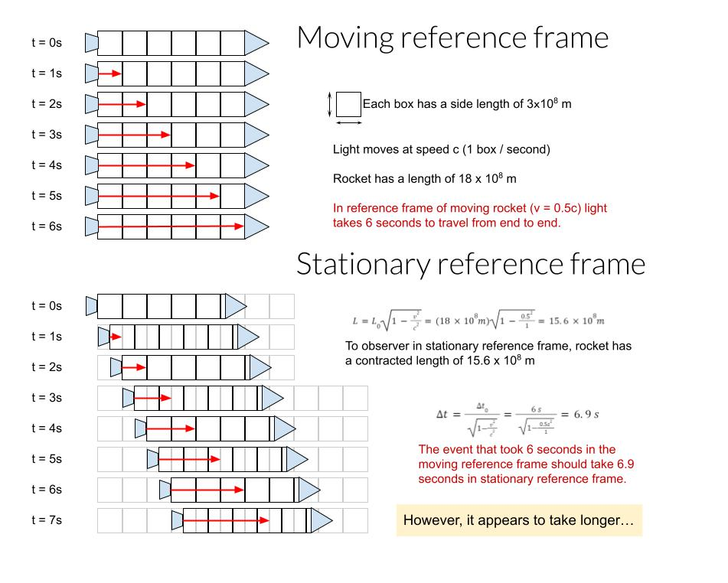
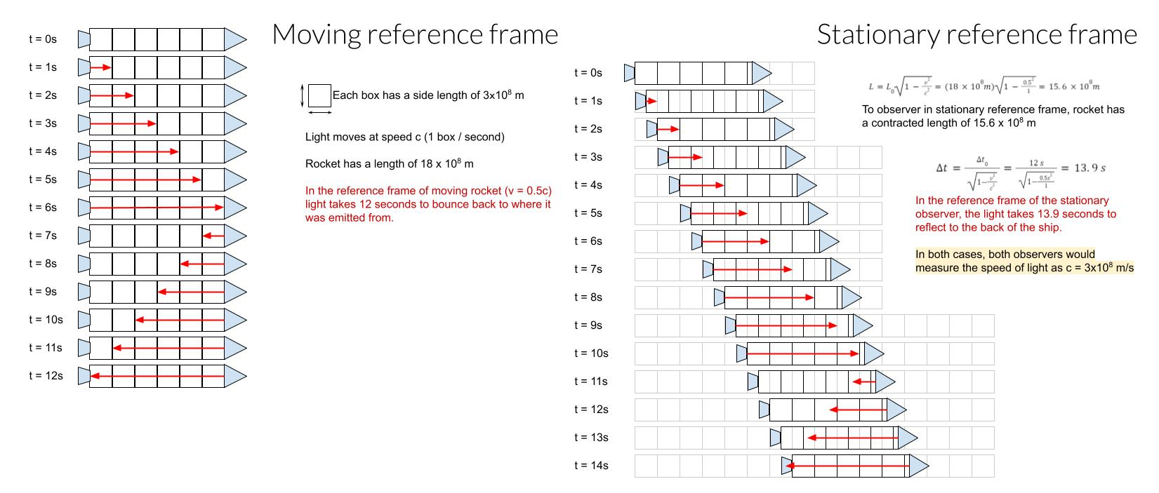

Slide 22

1 ly
3/4 c
t = 0 y
t = 1 y
t = 4/3 y

Slide 24
Notes:
(is this correct, look at aether calculations) To be an analogy of aether model should the rocks not be floating balls that float with the current at its speed, i.e. the aether effecting the fish’s speed and moving the floating balls to then lead to a difference, and the only reason the aether experiment gave the result it did was because the light speed was not affected, could still be aether but it would only effect objects motion but not the lightspeed

Slide 28



Slide 32
Mirror
L
L
Light sources
light pulses
half silvered mirror/ Beam splitter
Aether movement relative to equipment
Detector

Slide 33




